Slide 1

Edward – Week 1 (1)
This past week consisted mostly of research on AWS, trying to connect the many services together, configuring AWS settings, and writing test code in XCode.

Slide 2
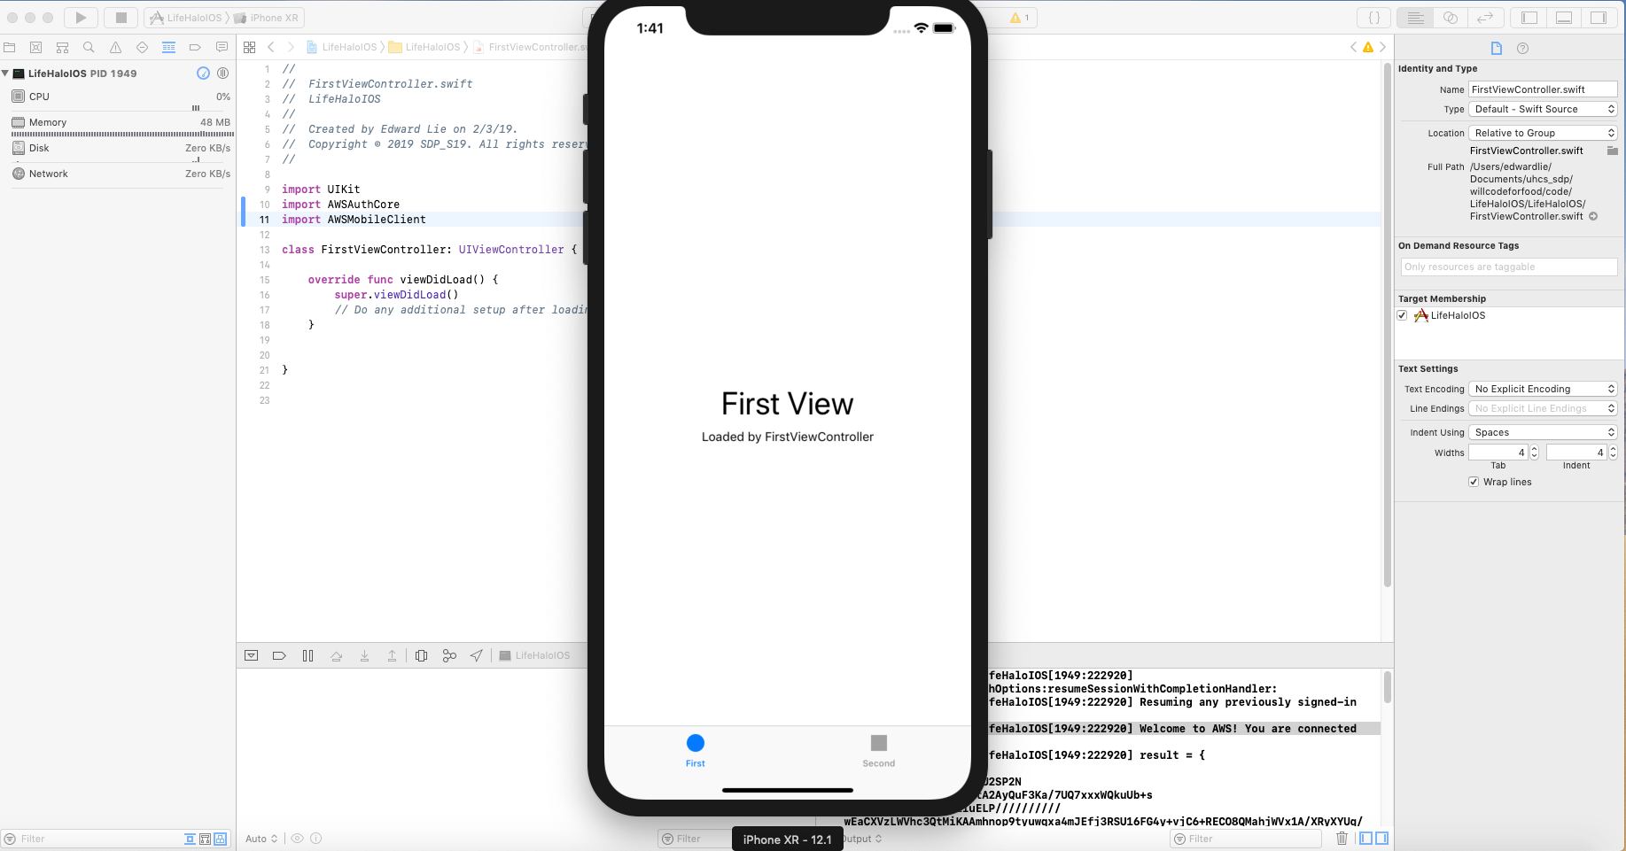
Edward – Week 1 (2)
Had issues with committing work to SVN as CocoaPods dependency manager contains file/folder with ‘Target Support Files’ when installed.
Resolved by establishing with teammates to individually commit files/folders that do not meet repository naming conventions.

Slide 3
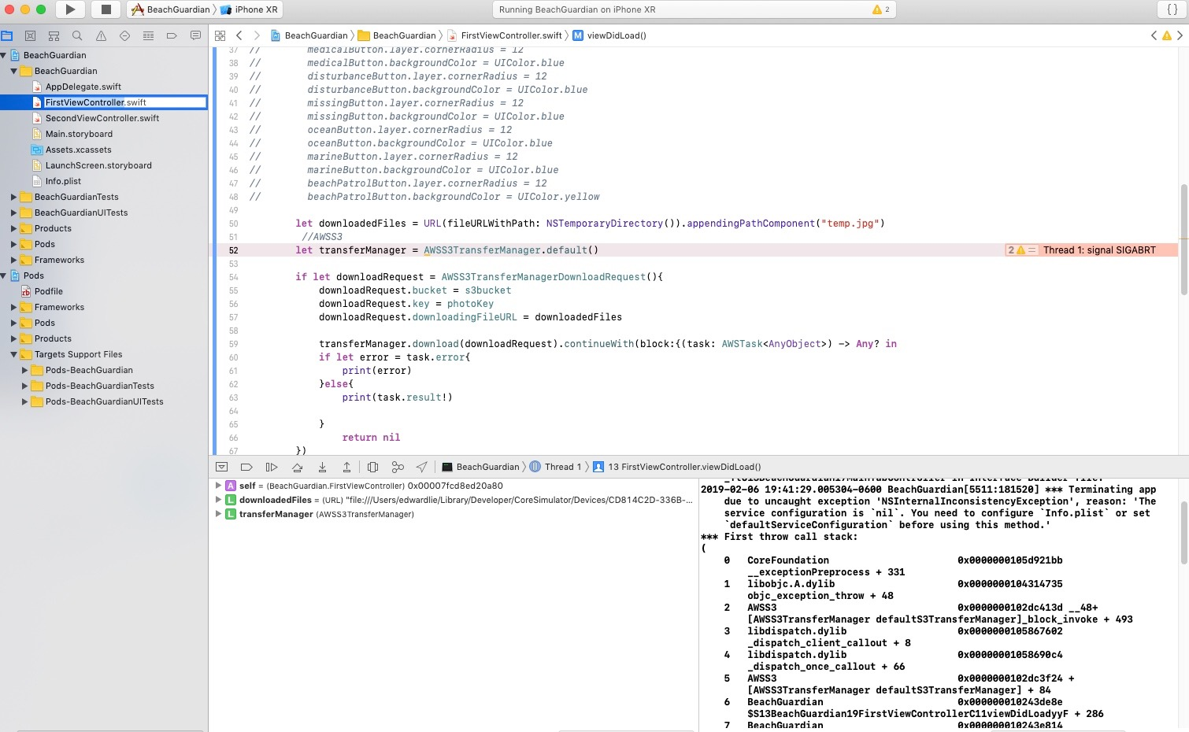
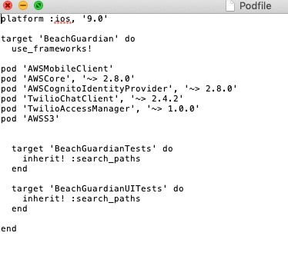
Edward – Week 1 (3)
Currently trying to figure out how to solve deprecated AWSS3TransferManager exception
Once other teammates began to push their code to SVN, I proceeded to integrate my work from earlier in the week to see if I could connect successfully.

